Slide 1
Study Tips: Best spots on Campus
Peer Advisor Freshman Seminar Series

Slide 2
Engage Your Professors
Questions about the assignments?
Go to office hours
Talk to your professor before/after class
Send emails
Take Effective Notes
Notes:
-Professors are very willing to help you but you need to ask
-Anything your professor writes on the board should appear in your notes because there is a good chance it will be on the test

Slide 3
3. Plan Ahead
Divide readings up into manageable chunks
Study for Quizzes and Tests
Start thinking of ideas for papers when the assignment is given
Notes:
-Divide readings up into manageable chunks (don’t read 200 pages at one time; you will not retain anything!)
-Study for Quizzes and Tests over the course of a week
-Start thinking of ideas for papers when the assignment is given

Slide 4
Open To Feedback
Go over mistakes on exams and assignments
Review professor’s remarks
Ask questions and participate
Notes:
Question anything you do not understand

Slide 5
Manage Your Surroundings
Don’t say you are studying when you’re really checking your Facebook, Twitter, Instagram etc.

Slide 6
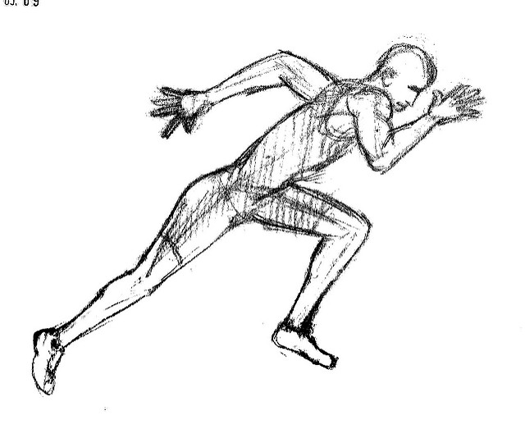
Keep Yourself in Tip-Top Shape
Never underestimate the value of sleeping and eating right
Schedule your eating and sleeping to make sure that you are taking care of yourself.
It’s difficult to excel if you’re feeling doomed to fail
Focus on your positive achievements

Slide 7
Challenge Yourself and Be Persistent
Think actively about what your reading
Don’t zone out or text when in class
Course work is tough
Extra work may be needed for some assignments

Slide 8
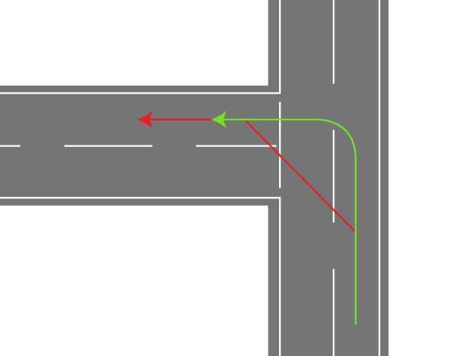
Don’t Cut Corners and Aim High
Stay on top of your work
Focus on important tasks you need to get done
Never strive for average

Slide 9
Visualize Success
Successful students know that college is their job and make doing well their highest priority
It helps to achieve a goal if you visualize yourself achieving it

Slide 10
Places to Study on Campus!
The Reading Room
Cyber Cafe
The Tech Lab
Academic Enrichment Center
The Dining Hall
The Library
The “L”
The Underground
Parmer Atrium

Slide 11
QUESTIONS?
MAKE SURE YOU DEDICATE YOUR TIME TO STUDYING!

